Slide 1
Involving students in SW-PBS: Adding student voice to the process and outcomes
Keith Hoyer
Montana Behavior Initiative
Blake Miller
Missouri SW-PBS
Tim Lewis
University of Missouri

Slide 2
Student Voice
SW-PBS as a Problem Solving Process
Data
What do we need & how will we know if it works
Practices
What we do to support students
Systems
What we do to support adults
What we do to support students????

Slide 3
Student Voice
Member of the SW-PBS Team
Connect points to existing student leadership groups
Student goal setting & progress monitoring
Students as exemplars
SW-PBS is something we do WITH students not to them

Slide 4
KINDNESS PROJECT
PLUMPTON EDUCATION COMMUNITY

Slide 5
The Kindness Project
Enhancing the anti-bullying strategy
Kindness as a “replacement” behaviour
3 tiered approach
Student-led
Across school learning community

Slide 6
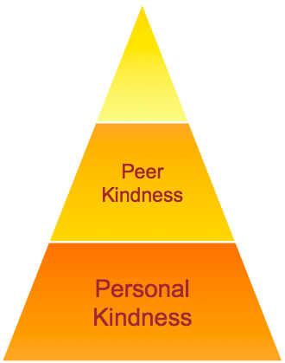
The Kindness Project
As with PBL and student leadership, a 3-tier model has been developed as a framework to nurture kindness at the school.
Public
Kindness

Slide 7
Types of Kindness Examples
Public
Kindness Ambassadors Charity Fundraising Kindness/Multicultural Day PEC, Community, Regional commitment
Peer
School Beautification Lunch/Breakfast club Public support for kindness Random Acts of Kindness (RAK) for / with a group
Personal
Random Acts of Kindness Pledge my commitment to being kind Achieving kindness goals Nominating someone for a Phoenix Personal Best Award (PPB)

Slide 8
The Student Ambassadors’ Plan
1. Meet with students and teachers to develop kindness strategies
2. Launch & promote kindness as a school-wide priority
3. Badge / wrist band and pledge signing
6.Stage 3-4 PEC kindness strategy
5.Kindness ambassadors as mediators / facilitators
4.Lunch club / breakfast club/ mentor project
7.Encourage kindness in community & link to CitCon
8.Group to organise multicultural day / kindness day

Slide 9
The Year of Kindness
We launched the Kindness project with the video and a bookmark project

Slide 10
Student Voice in Montana
Understanding what students say

Slide 11
How does Student Voice/Aspirations fit with MBI?
Capitalizing on what good teachers do every day
Attention to implicit curriculum
Inspire self-motivated students
Open dialog with student perspectives
Changes to infrastructure=changes in school climate
MBI is the umbrella
Notes:
Aspirations work is about doing what good teachers do intuitively on their best days, and doing so with greater INTENTION. It’s teaching students about math not math to students. The conditions we are going to talk about today are ideals and not norms. We want all students to be at 100%; however, it is a process….
Aspirations are about the IMPLICIT curriculum, not the explicit curriculum. It’s about how we teach and who we are when we are teaching.
The Conditions are about creating SELF-inspired and SELF-motivated learners.
Aspirations work seeks to INVOLVE everyone’s perspective, which is why we are using the My Voice Surveys as one of the basis of our action planning. The survey is about Student Voice. Focus groups
Ultimately, Aspirations work seeks to transform not just the way individual teachers interact with students, but the policies, procedures, norms, and customs of the school. It is about changes to school systems and structures—infrastructure—that have the biggest impact on a school’s culture.
The aspirations are one of the parts under the MBI umbrella.

Slide 12
Montana Data: Belonging
What does a welcoming school look like to students?
How do boys and girls define bullying differently?
2012 Montana Data
“Students don’t drop out because they can’t do math. Students drop out because they don’t belong”
Notes:
These findings may surprise teachers and school leaders who make an effort to get to know their students and to create a sense of community within the school building. If we are to increase the number of students who feel connected to their school, we must ask students how they would foster a welcoming and supportive school environment. If we listen to the voices of students and how they understand the Condition of Belonging, we may also see more positive results in the area of school pride, which less than half of the students surveyed say they feel..
Students’ feeling of acceptance is relatively positive, with approximately 7 out of 10 students feeling accepted for who they are at school. However, the finding that less than half (46%) of the students feel valued for who they are is cause for concern. Acceptance is important, but not enough; feeling valued for who they are, and truly cared about as individuals, helps students develop a sense of self-worth. The finding that less than half of the students surveyed believe their teachers care about their problems and feelings is also troubling. While most teachers would claim they care deeply about their students, it is critical teachers show they care in ways that are meaningful to their students.

Slide 13
Montana Data: Heroes
What does respect look like? Define respect with your students
How do boys and girls view teachers as role models differently?
Model and expect respect
Incorporate traditions and cultures
2012 Montana Data
“Heroes build trust in others and belief in oneself”
Notes:
Students’ responses to these statements tell us three critical things. First, although teachers have the potential to inspire and support students, they are not consistently doing so in ways students recognize. The finding that three fourths of students say they have a teacher who is a positive role model is encouraging. Yet far fewer students report that teachers respect students, are concerned about them as individuals, or care if they are even present in their classes. One conclusion is that even though many students find a role model among their teachers, they have less favorable perceptions of teachers’ attitudes toward them in general. These findings reveal a need for everyone in the teaching profession, not just a “cool” or select few, to capitalize on the inherent opportunity to be a hero by showing students they genuinely care and are ready and willing to support them.
Second, these results emphasize that students perceive a general lack of respect in their schools. While just 66% believe teachers respect students—a worrisome result in itself—the fact that even fewer think students respect teachers is troubling. The challenge of engaging students in their learning increases significantly if there is an essential lack of respect on either side. Perhaps most alarming, however, is that just 1 in 3 students believes students respect one another. Students, too, are in a position to be supportive of their peers and role models in the learning environment. In a climate of disrespect, the chances of such student-to-student support will be difficult to foster.
Third, clearly most students believe their parents care about their education. This figure might challenge educators who believe one of the difficulties of teaching is a lack of support and care for education in the home. With nearly all students reporting that they have parents who care, we are left wondering if the issue is parents not caring the way we want them

Slide 14
Montana Data: Sense of Accomplishments
Why do 16% give up when schoolwork is difficult; yet, 73% say they put forth their best effort at school?
Create opportunities for students to assess themselves
2012 Montana Data
“Four positives for every negative”
Notes:
Students appear to understand that schools expect them to achieve academically. While for those in a profession that highly values academics, the percentages could be higher, the majority of students say that getting good grades is important to them.
Although most of the students surveyed say they want to succeed in school, they are not necessarily putting forth the effort needed to achieve: close to one fifth of them give up when they encounter difficult schoolwork. Almost eight out of ten students say they try their best in school. Even fewer (58%) feel their teachers recognize them when they do try their best. The gap between wanting to achieve and putting in and sustaining the effort to meet that goal needs to be examined, as does the role teachers play in recognizing effort and perseverance.
The fact that so few students believe their teachers let their parents know what they do well is reflective of the need to communicate and celebrate student accomplishments. The data overall also reveal that schools need to do a better job of encouraging and recognizing student accomplishments of all kinds, including good citizenship. Schools traditionally recognize certain types of successful outcomes—high grades, athletic victories, etc. Yet all students need to be recognized for their unique talents and interests, as well as for the effort expended—even when the outcomes are not the ones originally hoped for.

Slide 15
Montana Data: Fun and Excitement
What is fun about school?
Blend student passion, interest and learning
Discover what students find interesting and boring
2012 Montana Data
“It is about students becoming so engaged in what they are learning they stop watching the clock and looking out the window”
Notes:
The percentage of students who believe learning can be fun is positive. Though this figure could certainly be higher, its importance is clear when contrasted with the high number of students who remain bored in school and say they do not enjoy being at school. Schools must capitalize on students’ belief that learning can be fun and employ methods that effectively engage students in the learning process.
Students’ perceptions of their teachers’ engagement in the learning process is even more striking. Students typically do not see their teachers as individuals who enjoy working with them. Whether this perception is true or not, these percentages should be an area of professional concern for all educators; educators must find ways to make clear to students that they enjoy working with them and are passionate about their role as educators.
The Condition of Fun & Excitement in today’s schools is not intended to imply that students should be laughing and playing instead of studying and learning. It is about students becoming so engaged in what they are learning they stop watching the clock and looking out the window. These findings lead us to ask: How can schools foster this experience throughout the curriculum?

Slide 16
Montana Data: Curiosity & Creativity
How are you encouraged to be creative at school?
Share your own curiosity.
Challenge curiosity by introducing novelty, surprise, complexity, uncertainty, or contradictions into lessons.
2012 Montana Data
“Teachers can no longer cover material; they, along with their students, uncover solutions”
Notes:
Statements about the Condition of Curiosity & Creativity reveal that 4 out of 5 students surveyed like to learn new things. Fewer, however, said that school inspires them to learn new things that are interesting. How can these percentages be improved? Students must feel safe and be engaged enough in their learning to ask “Why?” and “Why not?” Yet the data show approximately 1 out of 3 students do not feel comfortable asking questions in class. To foster genuine learning—and many of the skills being called for in the twenty-first century—students must have the chance to be creative while they are learning. Affording students the opportunity to be creative will help establish a learning environment that is inspiring to students; a necessary change, as just 3 out of 5 students report that school inspires them to learn.
In terms of relevance, approximately 2 out of 5 students said they see the connection between their current learning and their everyday lives. For students to maintain an active interest in learning, they must see a present value in it. They must be able to connect what they are studying to their world in some tangible way that leads them to ask questions and seek answers.
Interestingly, 80% of students believe what they learn in school is going to be helpful to them in the future. What does it mean if our students do not see school as relevant to their current lives, but do think it is beneficial for their future? If we do not make learning relevant and inherently rewarding in the present, we are failing our students—no matter how convincingly we argue they should defer the gratification of working hard in school for the sake of getting into the college or career of their dreams.
This goes back to fun and excitement. If you are into the lesson, the students are more likely to be receptive and feel comfortable. When they feel comfortable, they are more likely to participate and spark curiosity. It is a continuous cycle. The more you know about a subject the more comfortable you feel about exploring. The combination of cognitive domain (Bloom’s) and affective domain (feelings) sets the stage for creativity and curiosity.
Research shows that, if not nurtured, creativity takes a nosedive by fourth grade. Young children who were awesome artists in preschool no longer color the sky orange and pink just because they love the glowing colors. So how do we continue to encourage creativity and curiosity in today’s classroom where emphasis is put on testing knowledge?
-Create open-ended assignments
• Discover your students’ individual learning styles
• Incorporate art, music, and physical movement into your teaching
• Give students tools and skills to search for answers on their own
• Share your own curiosity with your students
• Explore new ideas and thoughts with your students
• Share different opinions, ideas and theories with your students
-most important- Make learning relevant for your students
Teachers can no longer cover material; they, along with their students, uncover solutions.

Slide 17
Montana Data: Spirit of Adventure
If you push yourself to do better in school, why do most students not like challenging assignments?
Why do more girls than boys get excited to share good grades?
2012 Montana Data
“Only those who will risk going too far can possibly find out how far one can go. -T. S. Eliot”
Notes:
Whether students have the courage to move beyond their panic or comfort zone into their challenge zone depends on overcoming fear, anxiety, and complacency. As the data show, approximately one-quarter of all students are reluctant to challenge themselves because they are afraid they might fail. This figure should be of concern to every educator. If students are not willing to challenge themselves—academically, socially, personally—how will they learn and grow as individuals? It must be just as safe for students to have a Spirit of Adventure and not succeed as it is for them to succeed when they take a healthy risk.
Less obvious, though no less worrisome, are the students who are afraid to challenge themselves because they might succeed. For these students, having a Spirit of Adventure means potentially threatening their social network—their sense of Belonging—and is therefore a powerful deterrent to success. The fact that just over half of the students surveyed are excited to tell their friends when they get good grades underscores this point. If all students are to reach their highest potential, schools must find ways to make it safe for all students to take on personal challenges and succeed at them.
Finally, the finding that approximately 2 out of 3 students believe teachers help them learn from their mistakes suggests students who try something new, and fail, need more sustained support so they do not give up. Deep understanding often follows failure, which is part of the self-correcting process of learning. Schools must also explore how students can be encouraged to support each other’s healthy risk taking so all students embrace new ideas and challenges throughout their education.

Slide 18
Montana Data: Leadership & Responsibility
Why is there such a large gap between “I see myself as a leader” and “other students see me as a leader”?
Give students a seat at the table where meaningful decisions are made – in your classroom, your school, and your community.
2012 Montana Data
“With leadership comes responsibility”
Notes:
The findings here reveal that although many students see themselves as leaders, this self-perception does not necessarily translate into leadership opportunities and action. This is most apparent in the fact that approximately 64% of students see themselves as leaders, while just over one third believe other students see them as leaders. For the Condition of Leadership & Responsibility to thrive, students’ sense of leadership cannot remain a merely internal phenomenon; students must manifest leadership in actions that are recognized by their peers and their communities, beginning at their school.
This discrepancy is perhaps explained by the findings about decision making and leadership opportunities. While the majority of students say they see themselves as good decision makers, just over two fifths of the students say they are aware of the goals their school community is working on or that students have a voice in decision making at their school. This reflects the need to foster students’ self-reported decision making skills with the meaningful opportunities to create change at school, an initial step of which is clear and open communication about the goals in the learning community and an invitation to help achieve them.
Another opportunity to foster Leadership & Responsibility in students exists in teachers’ everyday interactions with students. With just under half of students reporting that teachers are willing to learn from students, it becomes clear that taking time on a daily basis to listen to and learn from students would provide countless opportunities to place students in leadership roles.
It is not enough for students to see themselves as leaders and decision makers; they must put those beliefs into practice through genuine leadership opportunities. It is important to note that just under three-fourths of students believe teachers encourage students to be decision makers, and that almost half of students believe students have a voice in decision making at school. This suggests that creating leadership opportunities in classrooms might be a good starting point for school-wide initiatives.

Slide 19
Montana Data: Confidence to Take Action
In what ways do you think you can make a difference in the World?
Why the gender gap in “going to college is important to my future”
Work with students to realize their strengths
2012 Montana Data
“When the grass looks greener on the other side of the fence, it may be that they take better care of it there.”~ Cecil Selig
Notes:
There is a difference between dreaming about the future and taking the steps needed to reach those dreams. The Condition of Confidence to Take Action is defined by the successful integration of these two processes, and the majority of students surveyed appear to know it is important both to set high goals and work hard to reach them. Nonetheless, one 16% of students do not see goal setting as important. Educators must ask why as many as almost one third of students do not see a clear connection between school and the future they imagine for themselves. One explanation might be that not all students envision futures that benefit from scholastic efforts, yet nearly nine in ten students believe going to college is important for their future. What does this tell us about students’ understanding of the steps it takes to reach the goal of attending college and the role their present schooling is playing in that process? We must understand what it means that only three quarters of students think their teachers believe in them and expect them to be successful. Teachers play a key role in helping students believe in themselves and their abilities to reach their goals. If students don’t perceive teachers believe in them, they will certainly have greater difficulty believing in themselves.
Finally, while 93% of students think they can be successful, just over 80% know the kind of person they want to become, and still fewer believe they can make a difference in the world. Schools must foster students’ belief not only in their ability to succeed, but in their awareness of who they want to become and their ability to be engaged citizens who contribute to the world around them.

Slide 20
MBI and Student Voice
Youth Days
MBI Summer Institute
My Voice Survey
Focus Groups
Team Training

Slide 21
Students
Blake Miller

Slide 22
Blake Miller
Junior at Missouri State University
Studying Public Relations and Marketing
Involved with SW-PBS

Slide 23
SW-PBS at MGHS through the Teacher’s Eyes
Essential
Fun
Builds Unity
Successful
Notes:
Remember the successful. This will be a prominent point throughout my presentation.

Slide 24
SW-PBS at MGHS through the Student’s Eyes
Notes:
Unfortunately, students see it very differently, we see it as rules.

Slide 25
Change is needed
What kind of change?

Slide 26
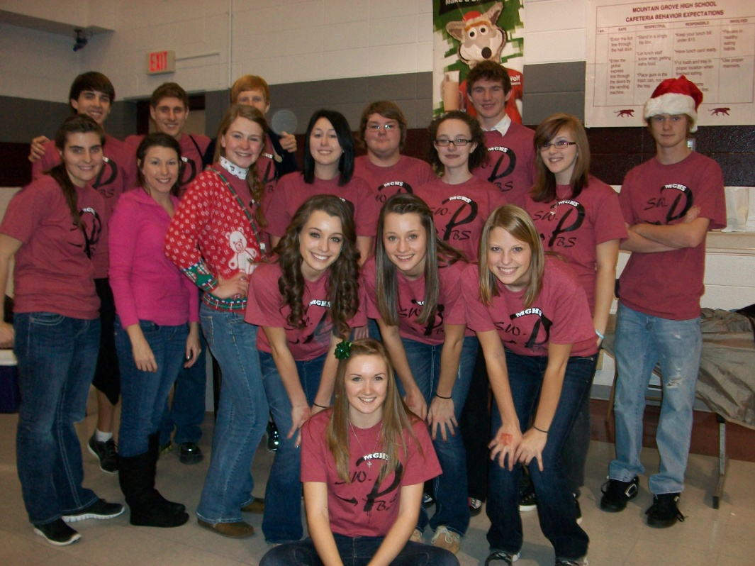
Student’s are the key to SUCCESS
Notes:
Which is why you are all here.

Slide 27
Changing SW-pbs
What did MGHS do to create a positive change?

Slide 28
Student Panel
What is the panel?
Humor
Student involvement in decisions
Less focus on rules and more focus on sucess

Slide 29
Benefits
Students feel more ownership of the SW-PBS initiative
Students want a direct impact on their school
Creates a positive school climate
Builds social skills for life
The Student Panel bridges the GAP between student and teacher
Builds unity within a school

Slide 30
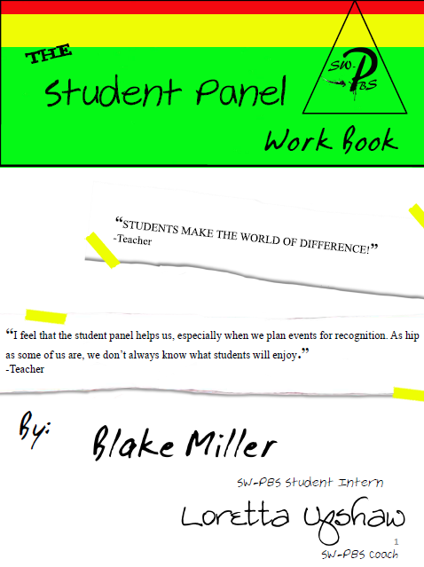
If you want help here is a book

Slide 31
Who will be on the Student Panel?
Faculty Nominations
Student Panel Nominations
Applications

Slide 32
Characteristics
Works well with others
Not over committed
Creative
Leadership potential
Not just the “good/smart/popular” kids
Innovative
Willing to be involved

Slide 33
Starting Off
One male and female per grade
Diverse
Clubs
Sports
Fine arts
Practical arts
Ethnicity
Socioeconomic

Slide 34
TEaching
Teaching the expected behaviors

Slide 35
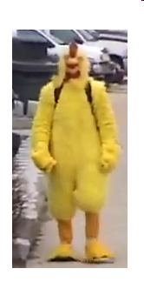
Videos
Chicken “cyber-bullying”
Lunch Card Monster
Bathroom Expectations
Classroom Expectations

Slide 36
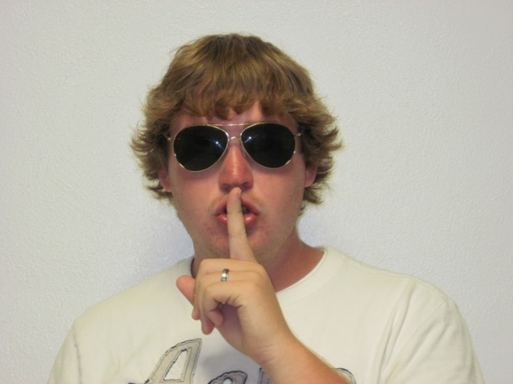
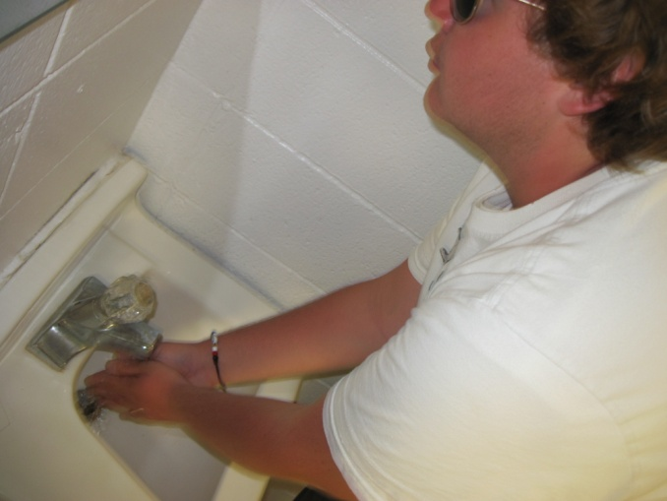
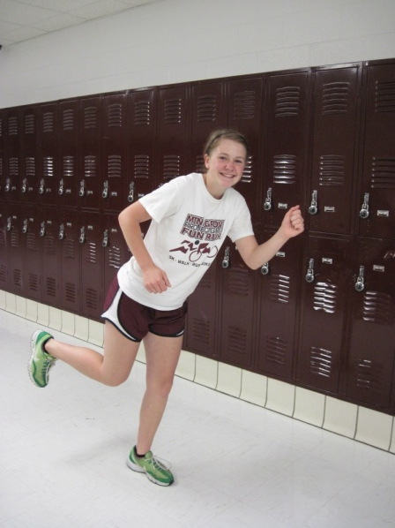
Bathroom Expectations
Hush
Flush
Wash
Rush
Notes:
Here’s an example of our latest project

Slide 37
Logo
Reminder
Expectation
Upcoming Events
Random “FUN”
Past event
pictures

Slide 38
Recognizing
Recognizing the expected behaviors

Slide 39
Panther Power Tickets
Panther Power Ticket
Good for one regular ballgame
Or
One .50 item from the MGHS Café
Or
collect tickets to trade in for other options (see back)
Level One
$.50 lunch item
Game Pass
Level Two
Parking Pass
Homework Pass
Level Three
Prom Ticket Drawing
Yearbook Drawing

Slide 40
Community awareness
Making the community aware of the Student Panel’s actions

Slide 41
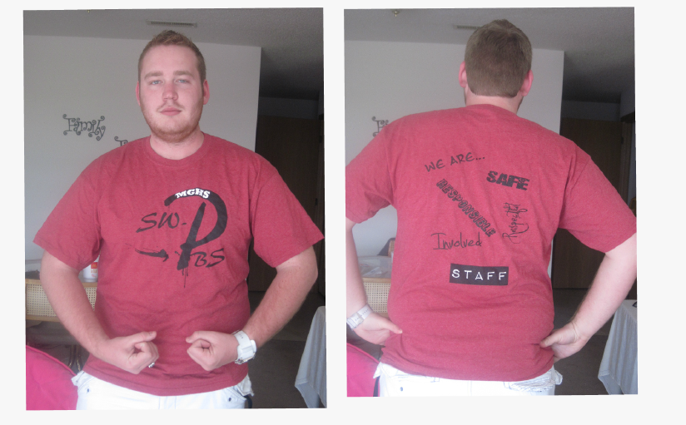
T-shirt

Slide 42
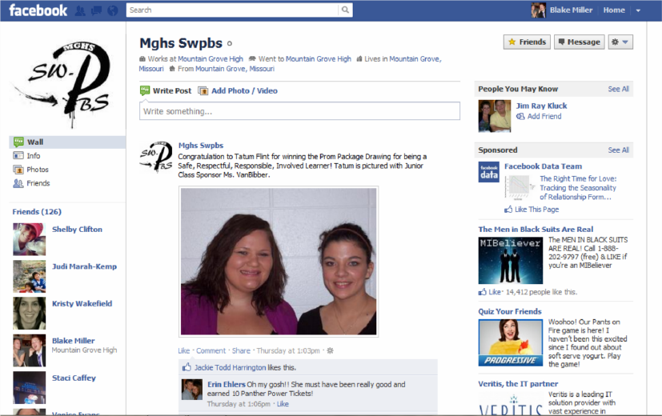

Slide 43
Contact Information
Student Panel Presenter
Blake Miller
blakemiller968@gmail.com
Student Panel Sponsor
Loretta Upshaw
lorettakupshaw@gmail.com

Slide 44
Involving students in SW-PBS: Adding student voice to the process and outcomes
Keith Hoyer
Montana Behavior Initiative
Blake Miller
Missouri SW-PBS
Tim Lewis
University of Missouri

