Slide 1
Wednesday, 9:15-10:30, Salon C

Slide 2
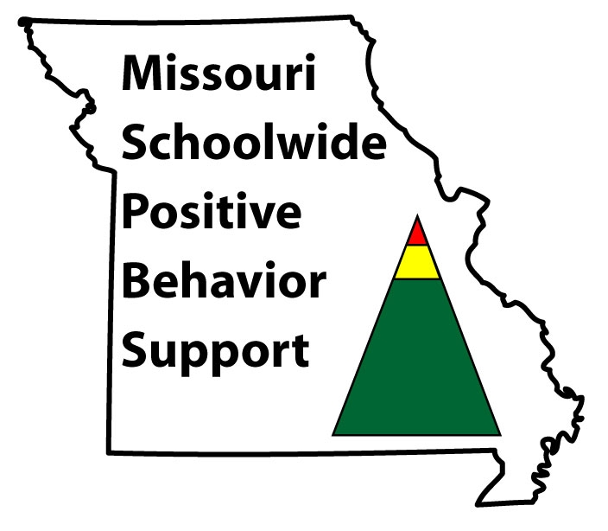
Group-Based Interventions for Tier 2 An Overview of Research Supported Practices
Barbara Mitchell, Ph.D.
MO SWPBS Tier 2/3 Consultant

Slide 3
Outcome
By the end of this session you will be able to…
Identify and select interventions that fit the needs and context of students and staff.
Check-In/Check-Out
Social Skills Intervention Groups
Check & Connect
First Step to Success
MO SW-PBS

Slide 4
Three Levels of Implementation
A Continuum of Support for All
Academic Systems
Behavioral Systems
Tier Three
Individual Students
Assessment-based
High Intensity
Tier Three
Individual Students
Assessment-based
Intense, durable procedures
Tier Two
Some students (at-risk)
High efficiency
Rapid response
Tier Two
Some students (at-risk)
High efficiency
Rapid response
Tier One
All students
Preventive, proactive
Tier One
All settings, all students
Preventive, proactive
MO SW-PBS

Slide 5
Key Features of Tier 2
Standard identification process and criteria.
A bank of research-based interventions that are continuously available and matched to identified need and function of problem.
Data used to monitor progress and make decisions.
MO SW-PBS

Slide 6
Purpose of Tier 2
Provide interventions to support approximately 15% of the student population who are at risk, but not currently engaging in severe problem behavior
Walker & Horner, 1996;
Crone, Hawken & Horner, 2010, p. 7
MO SW-PBS

Slide 7
Purpose of Tier 2
Not all students require an intensive, individualized intervention
Research-based interventions can be effective in preventing severe problem behavior
Group-based interventions allow use of fewer resources while still providing positive effect
MO SW-PBS

Slide 8
The Behavior Education Program (BEP): A Daily Check-in/Check-out Intervention (CICO)
Crone, Hawken, & Horner, 2010
The Guilford Press

Slide 9
Crone, D. A., Hawken, L. S. & Horner, R. H. (2010). Responding to Problem Behavior in Schools: The Behavior Education Program. New York: Guilford Press.
MO SW-PBS

Slide 10
Check-In/Check-Out
Basic Cycle
Morning check-in (Get Daily Progress Report)
Regular teacher feedback throughout day
End of day check-out
Tally and record points
Receive recognition
Data collection & progress monitoring
Take DPR home & return signed copy
MO SW-PBS

Slide 12
Video Example
MO SW-PBS

Slide 13
What Resources Are Needed?
CICO Coordinator
Facilitator A
Student 1
Student 2
Facilitator B
Student 3
Student 4
MO SW-PBS

Slide 14
Check-In/Check-Out
Research supported practice
Decreases problem behavior
Effective for 60-75% of second tier, at-risk students
Schools can successfully implement
Less effective for students who do not find adult attention reinforcing
Use of Functional Behavior Assessment can enhance success
(Crone, Hawken & Horner, 2010, p. 11)
MO SW-PBS

Slide 15
Social Skills Intervention Group
Definitions & Best Practice

Slide 16
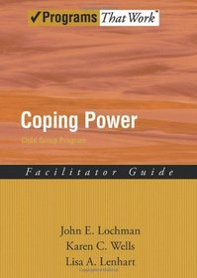
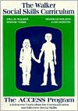
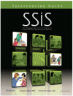
Example Manuals

Slide 17
Reasons for Social Skill Deficits
Lack of knowledge
Lack of practice
Lack of cues
Lack of reinforcement
Presence of competing problem behaviors
(Elliott and Gresham, 2008)
MO SW-PBS
Notes:
There are a variety of reasons why students may demonstrate a social skill deficit….

Slide 18
Instructional Approach
Tell = Coaching
Show = Modeling
Do =
Role Play
Practice = Rehearsal
Reinforce =
Feedback
MO SW-PBS

Slide 19
Preparation Phase
Identify Common Deficits
Gather Lessons
Plan for Generalization & Maintenance
Establish Session Procedures
MO SW-PBS

Slide 20
Implementation Phase
Notify Participants
Teach Skill Lessons
Monitor Progress
Evaluate Outcomes
MO SW-PBS

Slide 21
Video Example
MO SW-PBS

Slide 22
Check & Connect A Student Engagement Intervention
University of Minnesota
Institute on Community Integration
MO SW-PBS

Slide 23
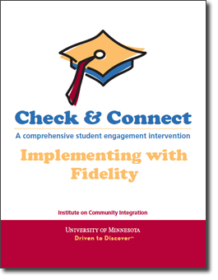
Intervention Manual - 2012
MO SW-PBS

Slide 24
What is Check & Connect?
Four components =
A mentor who works with students and families for a minimum of 2 years,
Regular “checks” using school data
Timely and individualized intervention - “connect”
Engagement with families
MO SW-PBS
Notes:
Check & Connect consists of 4 components (guiding principles):
A mentor works with students and partners with families for a minimum of two years,
regularly checking on the educational progress of the student,
intervening in a timely manner to reestablish and maintain the student’s connection to school and learning and to enhance the student’s social and academic competencies (C & C Manual, 2008, p. 1)

Slide 25
What is Check & Connect?
Three Core Elements (fundamental principles)
Relationships
Focus on alterable variables
Personalized, data-based intervention
Long-term commitment
Participation in and affiliation with school
Problem solving & capacity building
Persistence-Plus
MO SW-PBS

Slide 26
All Students Get
“Check”
Systematic Data Collection & Recording
All Students Get
“Connect”
Basic
Intensive
Share “check” data
Provide feedback
Discuss Importance of school
Teach Problem solving
Basic + Individualized, additional supports determined by need.
MO SW-PBS

Slide 27
Video Example
Center for Adolescent Research in Schools (CARS) – training video
MO SW-PBS

Slide 28
Resources Needed
Coordinator
Mentor 1
Student A
Student B
Mentor 2
Student C
Student D
Mentor 3
Student E
Student F
MO SW-PBS

Slide 29
Resources
*U.S. Department of Education
Institute of Education Sciences
What Works Clearinghouse
Web =
http://ies.ed.gov/ncee/wwc/
MO SW-PBS

Slide 30
Resources
*Institute on Community Integration
University of Minnesota
Web = http://ici.umn.edu/checkandconnect
Publications = Check & Connect: A comprehensive student engagement intervention (manual; cost is $50)
MO SW-PBS

Slide 31
First Step to Success Helping Young Children Overcome Antisocial Behavior
Walker, Golly, Severson, Kavanaugh, Stiller, & Feil

Slide 32
First Step to Success
Early intervention program designed to help children who are at risk for developing aggressive or antisocial behavioral patterns.
Behavior coach works with …
Student, Class Peers, & Teacher
Parents
Friday, 9:45-11:00, Salon A
MO SW-PBS

Slide 33
Outcome By the end of this session you will be able to…
Identify and select interventions that fit the needs and context of students and staff in your setting.
Check-In/Check-Out
Social Skills Intervention Groups
Check & Connect
First Step to Success
MO SW-PBS

Slide 34
Contact Information & Resources
Intervention Manuals
Web Sites
http://pbismissouri.org/teams/tier-2-workbook
http://ies.ed.gov/ncee/wwc/
http://ici.umn.edu/checkandconnect
http://firststeptosuccess.org/
MO SW-PBS

