Slide 1
Session Information
Session 3E
Crystal Ballroom
Thursday 10:30-11:45

Slide 2
Using a School-wide Universal Screening Process to Identify Students At-Risk
Julie Peterman- School Counselor
Katie Curtis- Classroom Teacher
Wyman Elementary, Rolla Public Schools
Barbara Mitchell, Ph.D.
MO SWPBS
MO SW-PBS

Slide 3
Session Outcomes
By the end of this session participants will be able to ….
Provide a rationale for using a school-wide screening process
Identify one or more instruments that can be used for screening
Describe a system for conducting school-wide screenings
MO SW-PBS

Slide 4
The Challenge
Mental, emotional, and behavioral health problems (MEB) affect 450 million worldwide (i.e., 1 out of 4)
Treatment and service for individuals experiencing mental health challenges is costly ($300 billion/year)
MEB challenges are associated with increased risk for negative outcomes including premature death.
MO SW-PBS

Slide 5
The Challenge
Approximately 14-20% of young people experience an MEB disorder at a given point in time (NRC & IOM, 2009, p. 15)
Close to 40% of young people have had at least one psychiatric diagnosis by the time they are 16 (Jaffee et al., 2005)
MO SW-PBS

Slide 6
The Challenge
Signs of potential MEB disorders are often evident at a very young age (Gilliam & Sharar, 2006)
One survey reported that half of all lifetime cases began by age 14 (Kessler et al., 2005)
U.S. sample data indicates median age at onset (Merikangas et al., 2010)
6 years for anxiety disorders,
11 for behavior disorders,
13 for mood disorders,
15 for substance use disorders
MO SW-PBS

Slide 7
The Challenge
Early onset of MEB disorders is predictive of lower school achievement as well as increased burden on the child welfare and juvenile justice systems (IOM, 2006)
Youth with MEB problems are at greater risk for later psychiatric and substance abuse problems (Gregory et al., 2007)
MO SW-PBS

Slide 8
The Challenge
Many MEB disorders rarely come to the attention of doctors or teachers (NRC & IOM, 2009, p. 37)
Fewer than 1 in 8 children with an MEB disorder is currently receiving treatment in the mental health or substance abuse systems
Only about 1 in 4 have ever received any treatment
Even if child meets criteria for DSM disorder this does NOT necessarily mean he/she receives special education services in school setting.
MO SW-PBS

Slide 9
The Good News!
Research has identified multiple factors that contribute to the development of MEB disorders.
Negative life events at family, school, peer and/or community level
Poverty
Family dysfunction and disruption
Child maltreatment
Community factors
School factors
(NRC & IOM, 2009, p. 16)
MO SW-PBS

Slide 10
The Good News!
Interventions for successfully intervening are available.
National Registry of Evidence Based Programs & Practices (NREPP) http://www.nrepp.samhsa.gov/
Institute of Education Sciences What Works Clearinghouse (WWC) http://ies.ed.gov/ncee/wwc/
Evidence Based Intervention Network (EBI) http://ebi.missouri.edu/
(NRC & IOM, 2009, p. 16)
MO SW-PBS

Slide 11
The Good News!
There is great potential to reduce the number of new cases of MEB disorders and improve the lives of youth who experience these challenges.
We are limited only by inefficient and ineffective systems!
(NRC & IOM, 2009, p. 16)
MO SW-PBS

Slide 12
Now is the Time
“We won’t be able to stop every violent act, but if there is even one thing that we can do to prevent any of these events, then we have a deep obligation, all of us, to try.”
- President Barack Obama
Top priorities =
make schools safer and increase access to mental health care providers & service
MO SW-PBS

Slide 13
Social Competence &
Academic Achievement
OUTCOMES
Supporting
Decision
Making
Supporting
Staff Behavior
SYSTEMS
DATA
PRACTICES
SW Positive
Behavior
Support
Supporting
Student Behavior
Notes:
We want to stay true to the basics of SW-PBS by building a system that is based on data decisions that will support those students who do not respond to solid Tier one school-wide, universal instruction.
Outcomes: Academic and behavioral targets for students who did not respond to Tier 1 Intervention that are endorsed and emphasized by students, families, and educators.
Practices: Interventions and strategies that are evidence based.
Data: Information that is used to identify status, need for change, and effects of interventions.
Systems: Supports that are needed to enable the accurate and durable implementation of practices of SW-PBS:
Team-Based Decision-Making
Training for ALL staff on procedures to teach replacement behaviors and support students receiving intervention.
Procedures to update and receive feedback from students, staff and parents.

Slide 14
Three Levels of Implementation
A Continuum of Support for All
Academic Systems
Behavioral Systems
Tier Three
Individual Students
Assessment-based
High Intensity
Tier Three
Individual Students
Assessment-based
Intense, durable procedures
Tier Two
Some students (at-risk)
High efficiency
Rapid response
Tier Two
Some students (at-risk)
High efficiency
Rapid response
Tier One
All students
Preventive, proactive
Tier One
All settings, all students
Preventive, proactive
MO SW-PBS

Slide 15
Purpose & Key Features of Tier 2
Use data to identify students who are at risk for difficulties.
Provide standardized interventions that support student needs.
Use data used to monitor progress and make decisions.
MO SW-PBS

Slide 16
Identification Process
Teacher Nomination
Existing School Data
Universal Screening Instrument
Allows for early intervention?
(e.g., sooner, rather than later)
Identifies externalizing & internalizing?
MO SW-PBS

Slide 17
Identification Process
Universal screening is recommended as an evidenced-based practice
President’s New Freedom Commission & Special Education Task Force
Surgeon General
Safe Schools/Healthy Students
MO SW-PBS

Slide 18
Identification Process
Advantages of systematic screening
Fast, efficient, and respectful
Include all children and youth of interest
If we make an error, the error tends to identify students who are not at-risk
Informs schools about the student population
Find groups of students with common needs
Facilitates resource mapping of services
(University of Oregon Institute on Violence and Destructive Behavior)
MO SW-PBS

Slide 19
Identification Process
Screening not common because…
Behavior is often viewed as purposeful rather than environmental
Schools tend to be a reactive rather than proactive with respect to behavior
Impression that kids will “grow out of it”
Concern about profiling/stigmatizing
Fear of costs and potential to identify large number of EBD students
MO SW-PBS

Slide 20
Identification Process
Screening Not Common Because
Easier to screen vision & hearing because response falls in the realm of the parents
Political realities of managing parent reactions to behavior screenings; confidentiality
Systems skill set
Do we know how to respond to behavior with the same confidence that we respond to academic concerns?
MO SW-PBS

Slide 21
Resources Available
MO SWPBS Tier 2 Team Workbook May 2014, Chapter 3 (www.pbismissouri.org)
Table of instruments
Legal requirements and considerations
Sample letter to parents
Example protocols
Social, Academic, & Emotional Behavior Risk Screener (SAEBRS)
Strengths & Difficulties Questionnaire (SDQ)
Behavioral & Emotional Screening System (BESS)
Systematic Screening for Behavior Disorders (SSBD)
MO SW-PBS
Notes:
Page 1 of Screening Instruments at a Glance
A copy of each of these instruments is provided for participants.

Slide 22
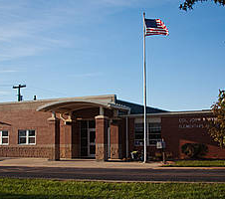
Wyman Elementary Rolla Public Schools K-4
530 students
Early Childhood Special Education
SW-PBS School for 11 years
MO SW-PBS

Slide 23
A Little Peek into our SW-PBS System
Tier One Practices
Buzz Bucks
Wyman Classroom Rules Posters
Universal Behavior Screening
Tier 2/3 Team
B.E.E. Card (Check In, Check Out)
FBA
Team Collaboration
Student Intervention Team (SAT)
Response to Intervention (RtI)
MO SW-PBS

Slide 24
Our Universal Behavior Screening Journey
Missing At-Risk Students
Must Screen ALL Students
Teacher Friendly
Time Effective
Cost Effective
Useful Results
MO SW-PBS

Slide 25
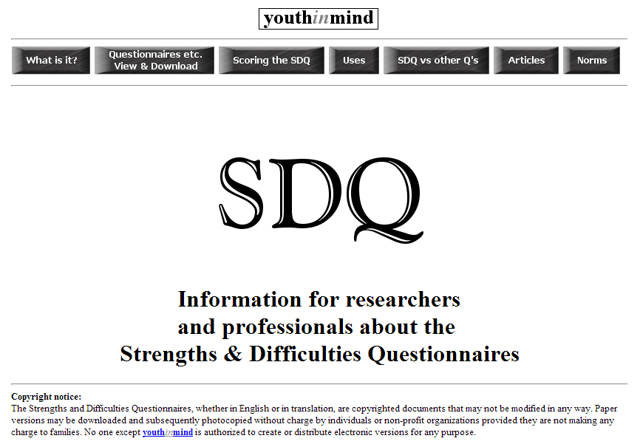
Strengths & Difficulties Questionnaire
Pros
Descriptive Individual Student Reports
Free
Cons
Technical Difficulties
No Class Data
MO SW-PBS

Slide 26
Student Risk Screening Scale (Drummond-1994)
The SRSS is a 7-item screener used to identify students who are at risk for antisocial behavior
Uses a 4-point Likert Scale
0=Never
1=Occasionally
2=Sometimes
3=Frequently
Teachers evaluate each student on the following items
Steal
Lie, cheat, sneak
Behavior problems
Peer rejection
Low academic achievement
Negative attitude
Aggressive behavior
Student Risk is divided into 3 categories
Low = 0 – 3 Moderate = 4 – 8 High = 9 - 21
MO SW-PBS

Slide 27
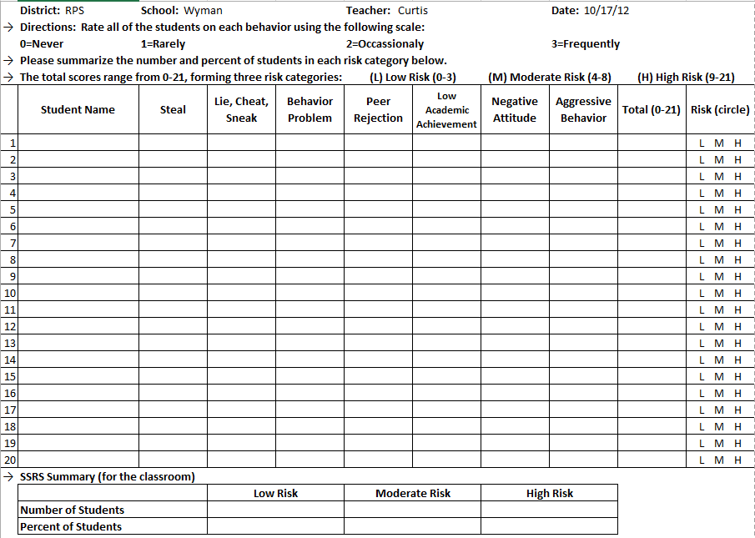
Student Risk Screening Scale (SRSS)
MO SW-PBS

Slide 28
Reporting Results
MO SW-PBS

Slide 29
What About Internalizing Behaviors? Student Internalizing Behavior Screening Scale (Cook, 2008)
The SIBSS is a 7-item screener used to identify students who are at risk for internalizing behavior
Uses a 4-point Likert Scale
0=Never
1=Occasionally
2=Sometimes
3=Frequently
Teachers evaluate each student on the following items
Nervous or Fearful
Bullied by Peers
Spends Time Alone
Low Academic Achievement
Withdrawn
Seems Sad or Unhappy
Complains About Being Sick or Hurt
Student Risk is divided into 3 categories
Low = 0 – 3 Moderate = 4 – 8 High = 9 - 21
MO SW-PBS

Slide 30
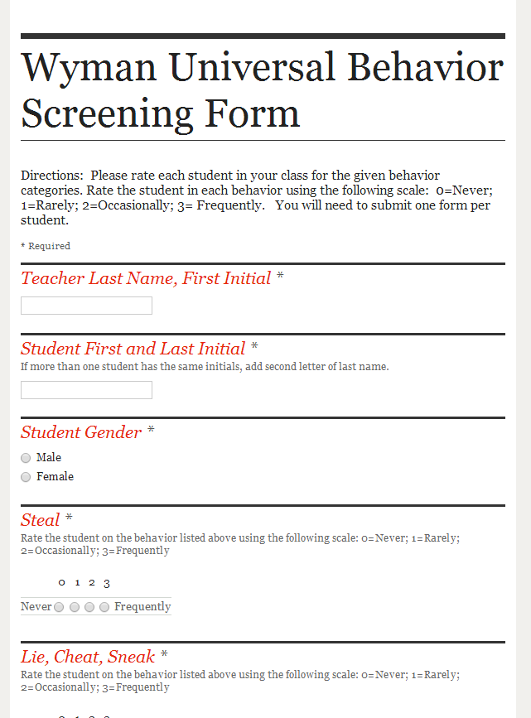
Compromise
Needed to Combine Both Screenings (SRSS and SIBSS)
Wanted Teacher Friendly
Created Google Form
http://mbcurl.me/MV9Y
MO SW-PBS

Slide 31
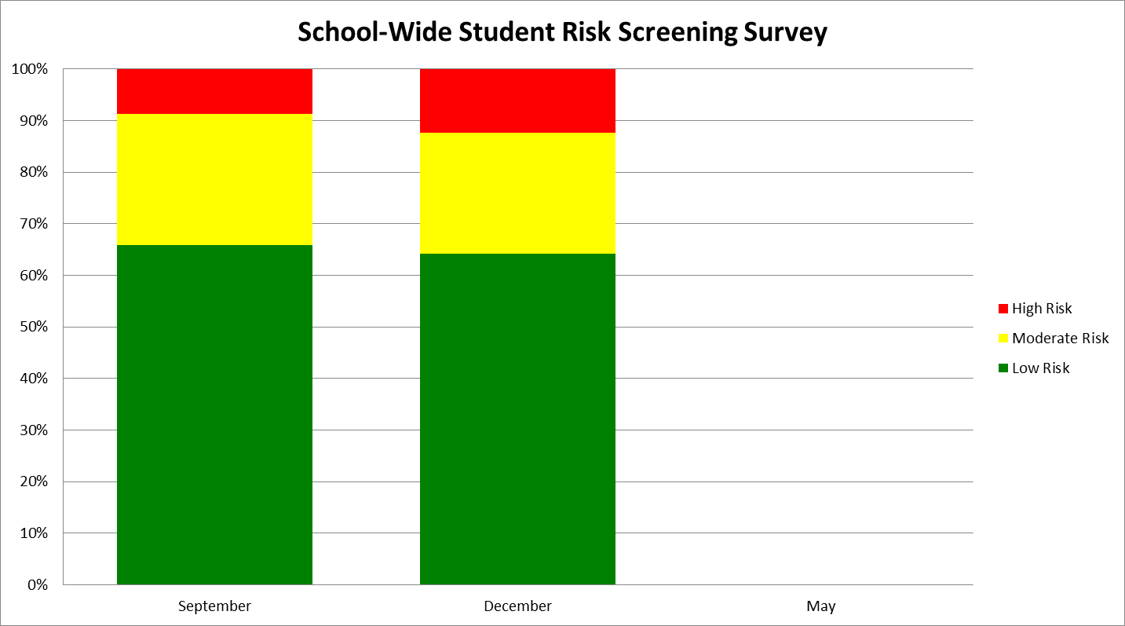
SRSS School Wide Data
MO SW-PBS

Slide 32
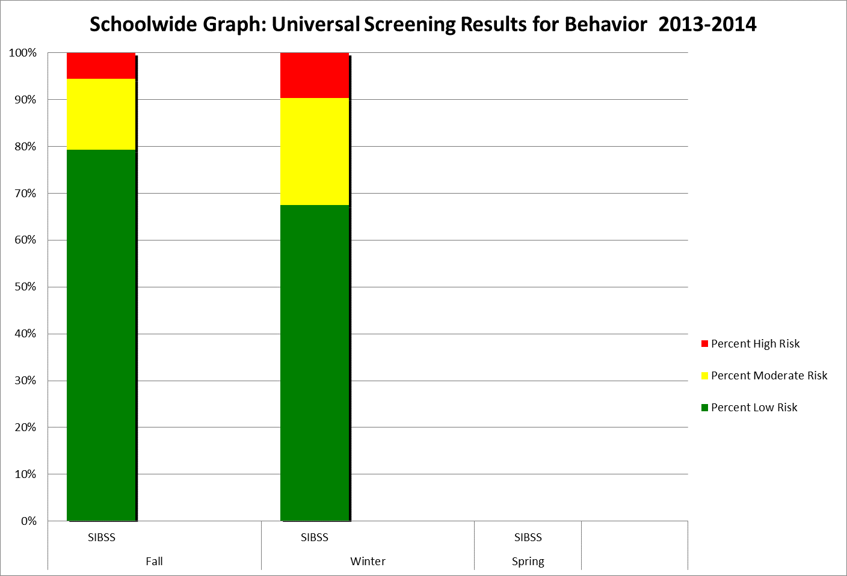
SIBSS School Wide Data
MO SW-PBS

Slide 33
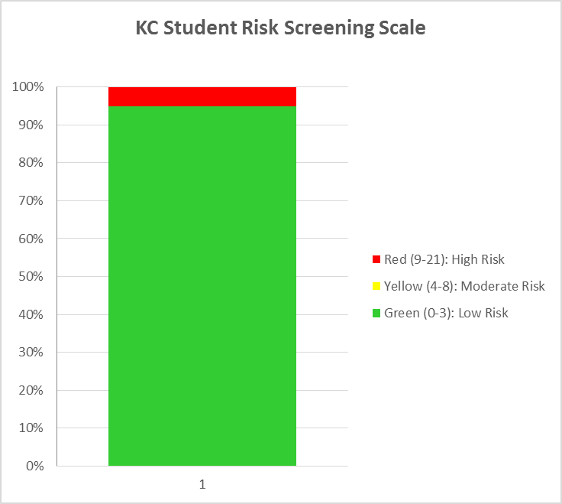
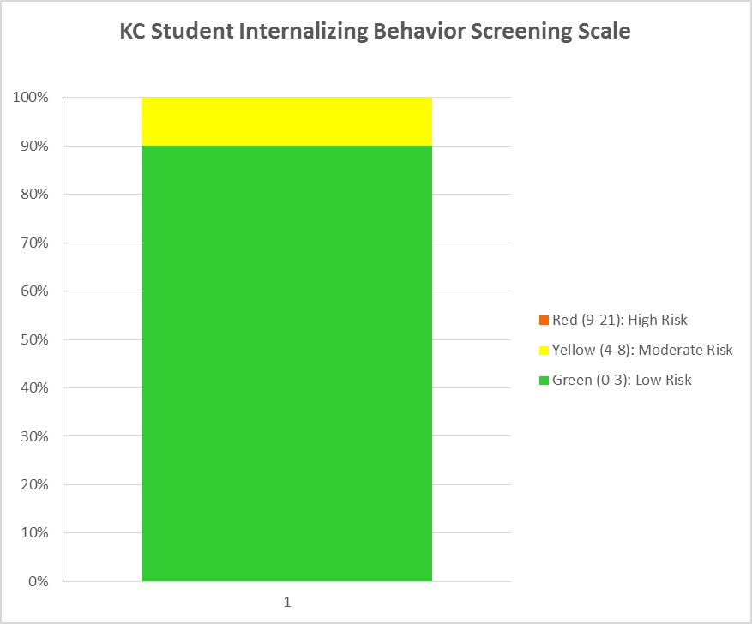
Individual Teacher Graphs
Student Risk Screening Scale
Student Internalizing Behavior Screening Scale
MO SW-PBS

Slide 34
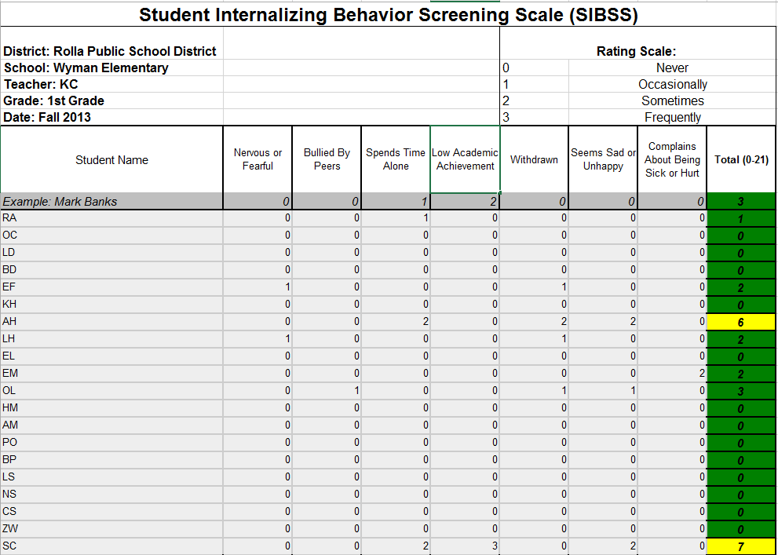
Individual Teacher Results
MO SW-PBS

Slide 35
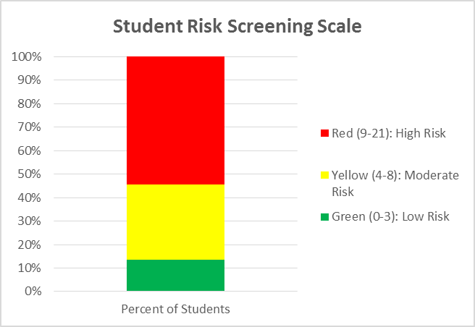
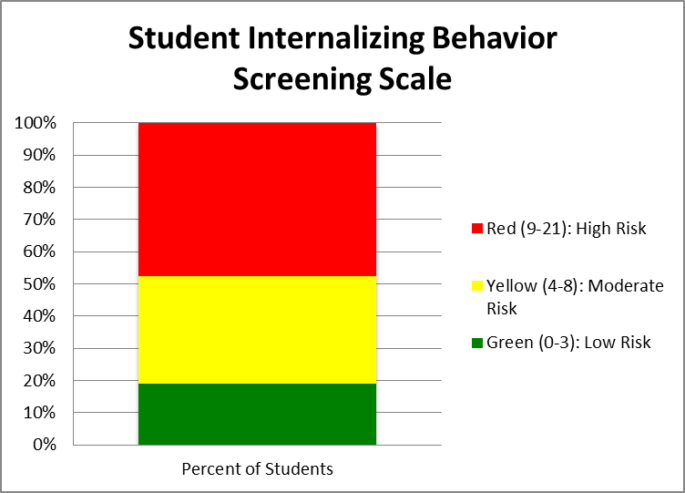
Individual Teacher Graphs
Student Risk Screening Scale
Student Internalizing Behavior Screening Scale
MO SW-PBS

Slide 36
Current Practice In Review
Early September
Presentation at Faculty Meeting
Share Link to Google Form
October
Share School Results with Staff
Distribute Teacher Results
Grade Level Sharing and Discussion
December and April
Share Link to Google Form
Share Results
Grade Level Sharing and Discussion
May
Review Process
Update as Needed
MO SW-PBS

Slide 37
We Have This Data, Now What?
Classroom Interventions
Social Skills Groups
Share with Student Assistance Team (SAT)
Use in Special Education Evaluations
Professional Development Opportunities
MO SW-PBS

Slide 38
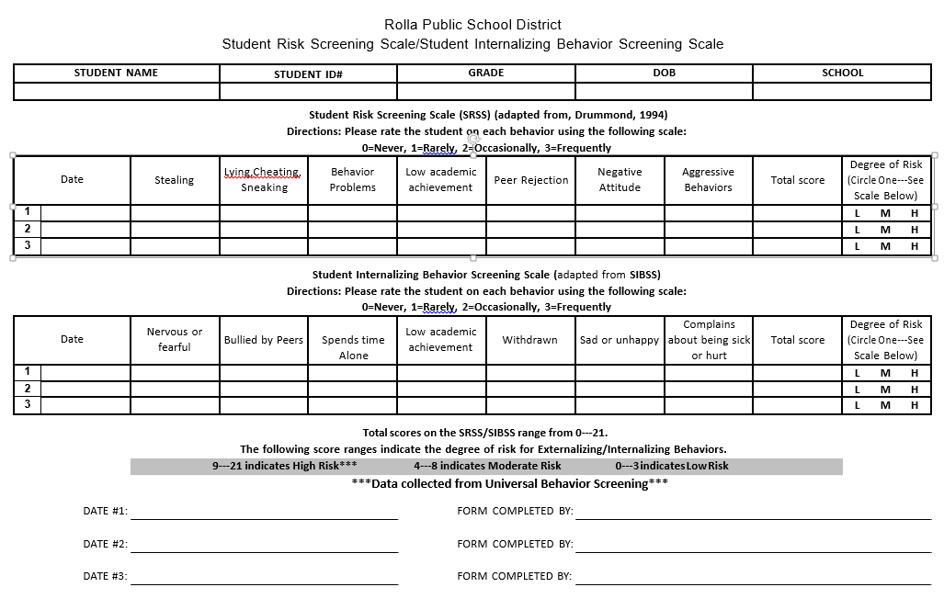
RtI Connection
MO SW-PBS

Slide 39
Extra Resources
http://miblsi.cenmi.org/MiBLSiModel/Evaluation/Measures/StudentRiskScreeningScale.aspx
http://rtinetwork.org/getstarted/checklists-and-forms
http://evaluation.ebrschools.org/eduWEB2/1000196/docs/scale_2__student_internalizing_beh_ss__-_sibss.pdf
MO SW-PBS

Slide 40
Session Outcomes
By the end of this session participants will be able to ….
Provide a rationale for using a school-wide screening process
Identify one or more instruments that can be used for screening
Describe a system for conducting school-wide screenings
MO SW-PBS

Slide 41
Contact Information
mitchellbs@missouri.edu
JPeterman@rolla.k12.mo.us
kcurtis@rolla.k12.mo.us

