Slide 1
Integrating Restorative Practices in a SW-PBS System: Can we reduce the need for suspension?
Tichelle Bruntmyer
University of Missouri

Slide 2
What’s the Problem?

Slide 3
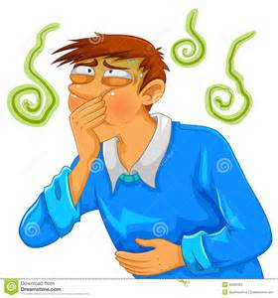
Zero Tolerance Policies
What’s your gut reaction?

Slide 4
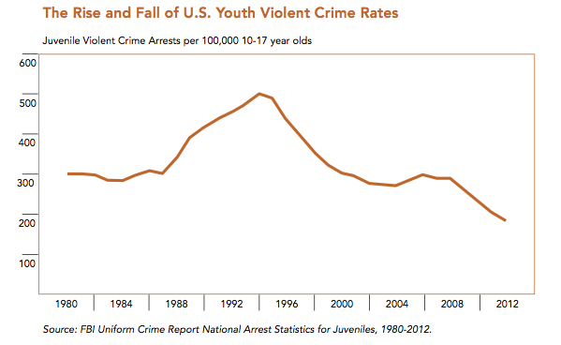
Where it came from
Gun-Free Schools Act (1994)
Congressional response to rising juvenile arrest rates of late 80s/early 90s
State laws that mandated expulsion of any student bringing a weapon to school for at least a year = federal education funds

Slide 5
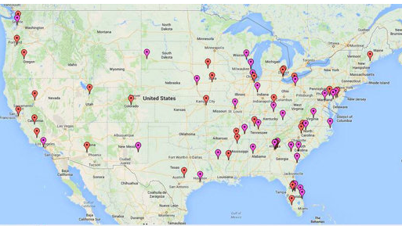
74 school shootings since Newtown
Notes:
One shooting every 7.35 days since Sandy Hook

Slide 6
Where it went
Suspension/expulsion for misdemeanors and minor offenses
Approximately 2 million children a year
5% for weapon possession
43% for insubordination

Slide 7
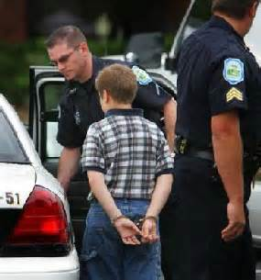
Where it Goes
TX study found 1 non-weapon suspension/expulsion tripled a student’s chances for JJ involvement

Slide 8
What’s the problem?
Deprives students of educational opportunities
ODRs
ISS/OSS
1 in 14 students in 2006 school year
Expulsion
Increases likelihood for JJ involvement
Fails to make schools safer

Slide 9
Is restorative justice the answer?

Slide 10
Definition of Restorative Justice
“… a way of responding to criminal behaviour by balancing the needs of the community, the victims and the offenders. It is an evolving concept that has given rise to different interpretation in different countries, one around which there is not always a perfect consensus.”
(United Nations, 2006)

Slide 11
Definition of Restorative Justice
“… a broad term which encompasses a growing social movement to institutionalize peaceful approaches to harm, problem-solving and violations of legal and human rights…”
(Center for Restorative Justice, 2011)

Slide 12
Definition of Restorative Justice
“Rather than privileging the law, professionals and the state, restorative resolutions engage those who are harmed, wrongdoers and their affected communities in search of solutions that promote repair, reconciliation and the rebuilding of relationships. Restorative justice seeks to build partnerships to reestablish mutual responsibility for constructive responses for wrongdoing in our communities.”
(Center for Restorative Justice, 2011)

Slide 13
Restorative Justice in 3’s
3 assumptions
Needs are created when people and relationships are harmed
Needs lead to obligations
The obligation is to “put right” the harm
(Van Wormer & Walker, 2013)

Slide 14
Restorative Justice in 3’s
3 principles
Repairs the harm caused by the wrongdoing (restoration)
Encourages responsibility for actions (accountability)
Involves the victims and community (engagement)
(Van Wormer & Walker, 2013)

Slide 15
Restorative Justice in 3’s
3 underlying values
Respect
Responsibility
Relationship
(Van Wormer & Walker, 2013)

Slide 16
Restorative Justice in 3’s
3 central questions
Who has been hurt?
What are their needs?
Who has the responsibility to restore the relationship?
(Van Wormer & Walker, 2013)

Slide 17
Restorative Justice in 3’s
3 stakeholder groups
Victim and their family
Offender and their family
Relevant community
(Van Wormer & Walker, 2013)

Slide 18
Pause for thought….
Consider the application of Restorative Justice with our kids…
What was it designed to address?
What types of issues are we wanting it to address in schools?
What adaptations would be needed for application in school?

Slide 19
Restorative justice in schools

Slide 20
RJ in Schools
Many names
Restorative practices, processes, approaches, discipline
Serves as an alternative to zero tolerance
Grounded in respect, responsibility, & relationships
Necessitates a shift from exclusion to connectedness with the school
Focuses on community-based problem solving

Slide 21
RJ in Schools
Meant to address harm and…
Create climate to promote healthy relationships
Build community
Develop social-emotional understanding and skills
Enhance teaching and learning

Slide 22
RJ in Schools
Restorative Circles
In the classroom:
Build community
Problem solve
Foster student-teacher relationship
Provide space for respectful dialogue to democratically establish classroom values

Slide 23
RJ in Schools
Restorative Circles
Outside the classroom:
May include conferencing with administrators
May include peer juries
May be used for more intense interventions such as:
Repairing damage
Reintegrating back into school after suspension/expulsion
Resolving differences

Slide 24
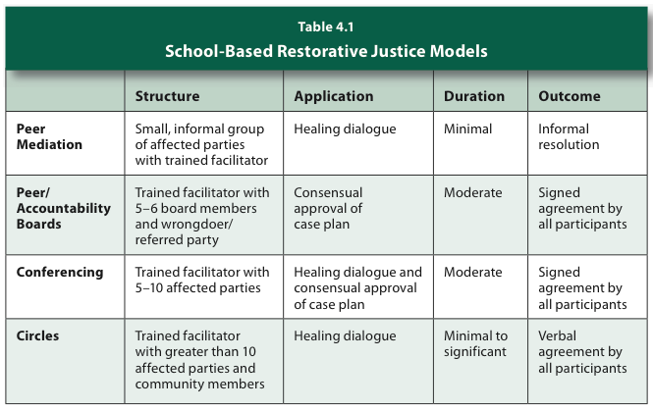
One Suggestion…
(Pavelka, 2012)

Slide 25
Early Reports of RJ in Schools
MN DoE
45-63% reduction of behavior referrals and suspensions in 2 schools, increase in academics
Cole Middle School, CA
87% reduction in suspensions
W Philadelphia High School, PA
52% reduction in violent acts and serious incidents in ‘07-’08; additional 40% in ’08-’09
Denver Public Middle Schools
90% reduction in ODRs and OSS across 7 schools
Notes:
No rigorous studies of RJ in schools. These are preliminary reports.

Slide 26
Ed White Middle School San Antonio, TX
An example:

Slide 27
Ed White Middle School San Antonio, TX
“Restorative Discipline”
3 year project beginning 2012-2013 school year
Goal: decrease instances of…
Bullying
Discipline referrals
Assignments to DAEP
Improve relationships between teachers, administrators, and students

Slide 28
Ed White Middle School San Antonio, TX
Demographics
Students (6th thru 8th grades)
985
30% African American
53% Hispanic
13% Caucasian
4% Asian/Pacific Islander
81.6% economically disadvantaged
Teachers
15% African American
20% Hispanic
61% Caucasian

Slide 29
Ed White Middle School San Antonio, TX
Questions:
What is the impact of RD on risk factors (e.g. suspension, absenteeism, bullying) of 6th grade students?
What is the impact on 6th grade school climate?
What is the experience of administrators who use RD for student misconduct and teachers who use RD in their classrooms?

Slide 30
Ed White Middle School: Implementation
Whole-school approach
Start with 6th grade, add a grade each year
Leadership Response Team + outside consultant
Teacher training:
2 days
Restorative justice and conducting restorative circles
6th grade teachers, principal, assistant principal, all staff associated with discipline and counseling

Slide 31
Ed White Middle School: Implementation
Classroom circles
Initially used to build community, problem solving class issues, teaching, & classroom management
Later, restorative circles for discipline
Eventually, 4th period used for RD circles
Leadership Response Team (LRT)
Dealt with more serious offenses
Outside consultant
Meet with LRT and teachers
Visit classrooms
Co-facilitate circles, when needed

Slide 32
Ed White Middle School: Restorative Circles/Conferences
Circle/Conference Agreement Forms:
Name and grade of participants
Description of incident
Agreement Details
How will harm be repaired?
How will harm be avoided in the future?
How will person who did the harm give back to the community?
What support will be given to the person harmed?
Monitoring Plan
Signatures

Slide 33
Ed White Middle School: Restorative Circles/Conferences
Circle-It Forms
Requested by students
Student uses to initiate circle or conference
Student indicates urgency of meeting
“today” or “tomorrow”
Primarily used to deal with peer conflict

Slide 34
Ed White Middle School: Restorative Circles/Conferences
Notes:
Blue = teacher/admin initiated meetings
Yellow = student requests

Slide 35
Ed White Middle School: Rates of Suspension
 | 6th Grade |  | % Change
 | 2011-2012 | 2012-2013
Partial day ISS | 75 | 167 (RD) | +123%
Partial Suspension | 12 | 11 | .8%
ISS | 468 | 329 | 30%
OSS | 66 | 11 | 84%
Notes:
RD circles and conferences were classified as “partial ISS”

Slide 36
Ed White Middle School: Infractions

Slide 37
Ed White Middle School: Bullying & RD Implementation
Notes:
“I apply restorative discipline principles consistently.”
1 = not in place
2 = partial
3 = in place

Slide 38
Ed White Middle School: Findings
OSS: 84% decrease
ISS: 30% decrease
School Climate Survey: parents and students had stronger sense of disciplinary fairness
Use and acceptance of RD was not consistent across teachers
Students responded favorably (e.g. Circle-it)
Teachers who used RD in the classroom improved relationships with students

Slide 39
Ed White Middle School: Recommendations
Teacher training includes practical application through concrete examples/role play
PD opportunities in RD throughout the year
Create a teacher handbook of philosophy, practices, and procedures
Plan for RD in non-classroom areas
Provide better/frequent feedback to teachers
Engage students through peer-mediated circles
Involve parents in circles, when appropriate

Slide 40
Pause for thought…
84% reduction in OSS and 30% reduction in ISS, but…
“These figures do not indicate a change in the frequency or nature of misconduct or more major offenses. Rather, they show the success of the school’s commitment not to extrude students or use punitive approaches to discipline.” (p. 6)
What could explain this finding?

Slide 41
Is there a better Approach?

Slide 42
Restorative practices within PBIS
SW-PBIS
Provides a tiered structure for organizing levels of prevention and making decisions regarding support needs
Offers a way to collect and analyze data
Goals of RJ and PBIS are similar, so how can they work together?

Slide 43
RJ in Tier 1
Goal of Tier 1:
Establish a predictable and positive environment
Direct teaching of expectations
RJ Inclusion: Circles
Periodically at the beginning of the school day to review or re-teach
Used to pre-correct behavior
How would theft of property affect the class?
Discuss issues that are concerning the class
Current or local events that might be concerning

Slide 44
RJ in Tier 2
Goal of Tier 2:
Provide additional support for students who aren’t successful at the universal level
RJ Inclusion
Peer juries
Proceed with caution!
Group-based restorative protocols
Includes person who committed harm, person harmed, teacher, and any other relevant stakeholders
Plans to prevent future occurrence

Slide 45
RJ in Tier 3
Goal of Tier 3:
To provide individualized support for students with the most pervasive needs
RJ Inclusion
Administrative conferencing
Student(s) committing harm, student(s) harmed, teacher, school administrator, parents of involved students
Develop plan to repair damage, teach appropriate replacement behaviors, restore relationships, prevent future occurrences

Slide 46
DATA!
How many whole class (tier 1), small group (tier 2), administrative (tier 3) conferences are you having?
Who initiates advanced tier conferences? (i.e. teachers, admin, students)
Is the integration of restorative practices having an influence on ODRs, suspensions, and expulsions? If not, why?

Slide 47
Food for thought…
Conduct a resource analysis
How can this fit within our current system?
What will it cost us in time, personnel, etc.?
What are our needs according to our data?
Don’t settle
Decreases in suspension and expulsion are GREAT! but it’s not enough
Continue to strive for high rates of appropriate behavior by teaching expectations

Slide 48
Food for thought…
Remember what you know about behavior
Inappropriate behavior will continue to occur unless you teach an acceptable replacement
Be patient!
RJ involves empathy

Slide 49
THANK YOU!!
Tichelle Bruntmyer
dtb8db@mail.missouri.edu

Slide 50
References
Armour, M. (2013). Ed White middle school restorative discipline
evaluation: Implementation and impact, 2012/2013 sixth grade. The Institute for Restorative Justice and Restorative Dialogue. Austin: The University of Texas at Austin.
Gonzalez, T. (2012). Keeping kids in schools: Restorative justice,
punitive discipline, and the school to prison pipeline. Journal of Law & Education , 41 (2), 281-335.
Kang-Brown, J., Trone, J., & Daftary-Kapur, T. (2013). A generation
later: What we've learned about zero tolerance in schools. Center on Youth Justice. New York: VERA Institute of Justice.
Pavelka, S. (2012). Practices and policies for implementing
restorative justice within schools. The Prevention Reseracher , 20 (1), 15-17.
van Wormer, K., & Walker, L. (2013). Restorative justice today: Practical
applications. Los Angeles: Sage Publications.

