Slide 1
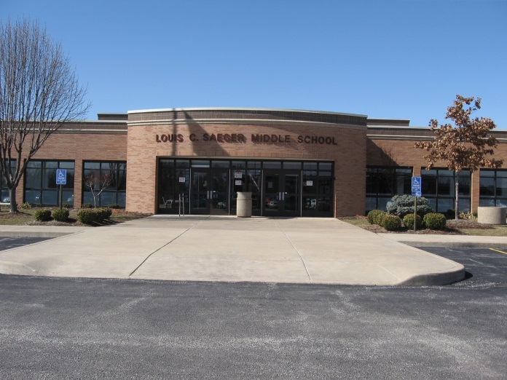
The Spartan Way
Saeger Middle School
PBS 101
Thwarting Tier 2

Slide 2
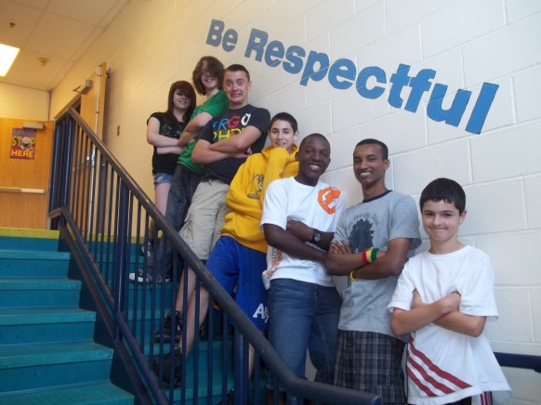
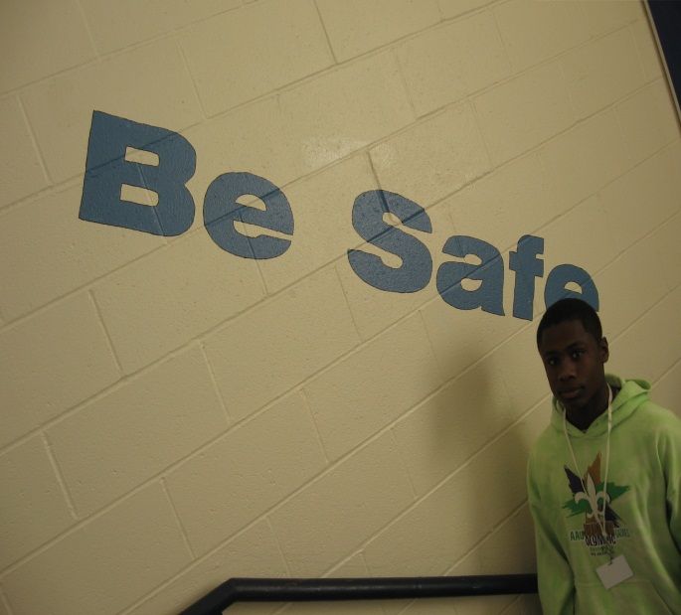
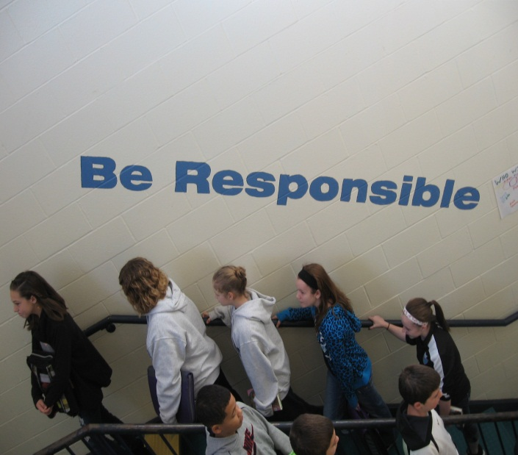
Who is Saeger?
760 students in grades 6 – 8
13% SpEd, 19% Free/Reduced, 3% ESL
Our 7th year in SW-PBS
Procedures in place for Tiers 1, 2, & 3

Slide 3

Prior to Implementation
In 2005-2006, we had 2335 total discipline incidents (only 760 students)
    1772 detention incidents
    175 Saturday detentions
    415 in-school suspension incidents
    96 out-of-school suspension incidents

Slide 4
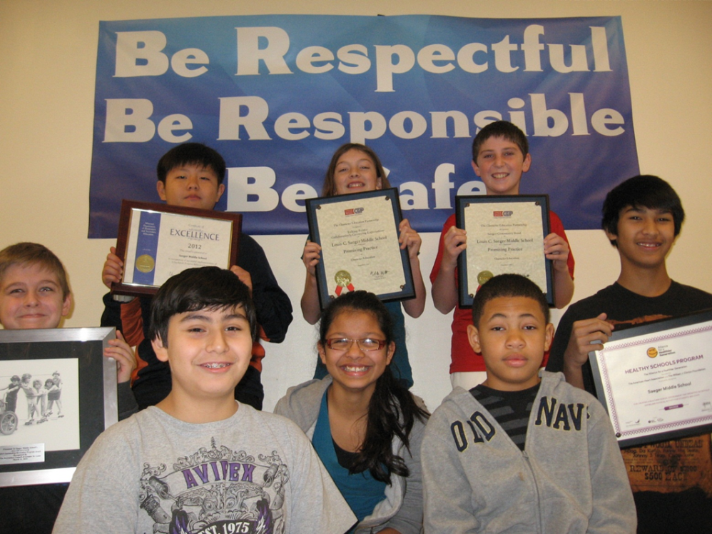
Since Implementation
Received gold level recognition from the state at the Summer Institute in 2012 & 2013
64.41% decrease in number of behavior incidents as of 2012-2013.

Slide 5
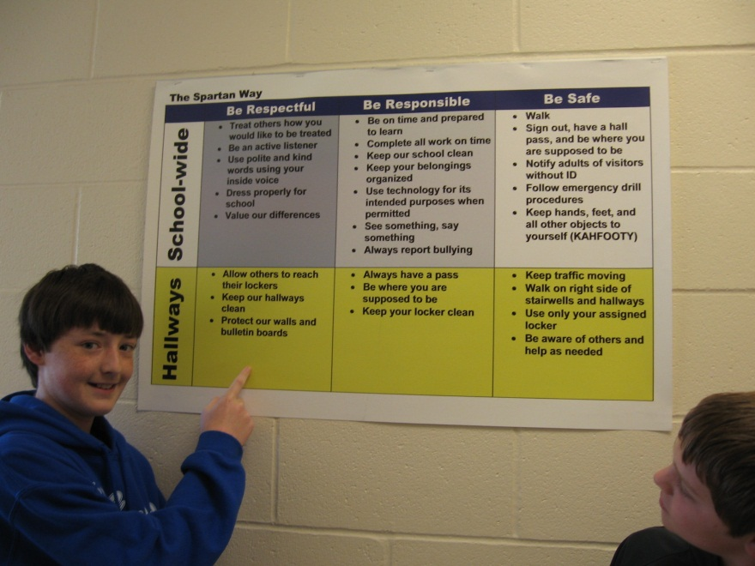
Since Implementation
A 41% decrease in the number of classroom incidents in the past year alone.
We write approximately 3,800 positive, caught-cha recognitions every year.

Slide 6
Spartan Way Tier 1
Universal efforts are undertaken with all students to teach expectations and reinforce appropriate behavior.
 | Be Respectful | Be Responsible | Be Safe
School-wide | Treat others how you would like to be treated Be an active listener Use polite and kind words using your inside voice Dress properly for school Value our differences | Be on time and prepared to learn Complete all work on time Keep our school clean Keep your belongings organized Use technology for its intended purposes when permitted See something, say something Always report bullying | Walk Sign out, have a hall pass, and be where you are supposed to be Notify adults of visitors without ID Follow emergency drill procedures Keep hands, feet, and all other objects to yourself (KAHFOOTY)

Slide 7
Spartan Way Tier 1 Teaching
Weekly positive behavior support “Talking Points”
    Keeping our school clean “We ♥ Our Custodians”
    Proper bathroom etiquette “Hush, Flush, Wash, & Rush”
    Homework completion “Got Homework?”
    Anti-Bullying “See Something, Say Something”
Monthly school-wide character lessons based on behavior data
    Respect for School Equipment
    Gossip Hurts
    Expect Respect
    Spartan Way-Positive Behavior Support - Saeger Middle

Slide 8
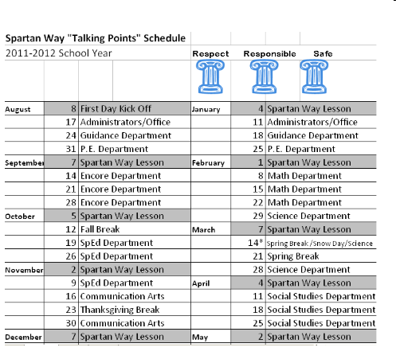
Talking Points

Slide 9
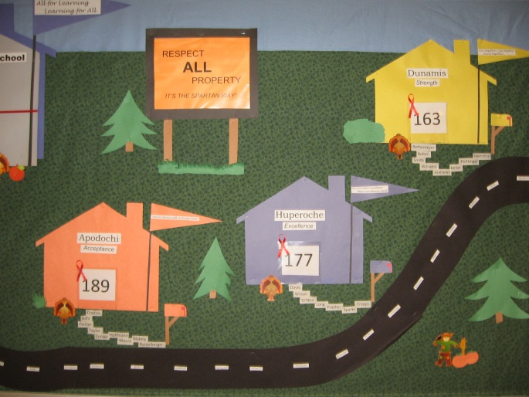
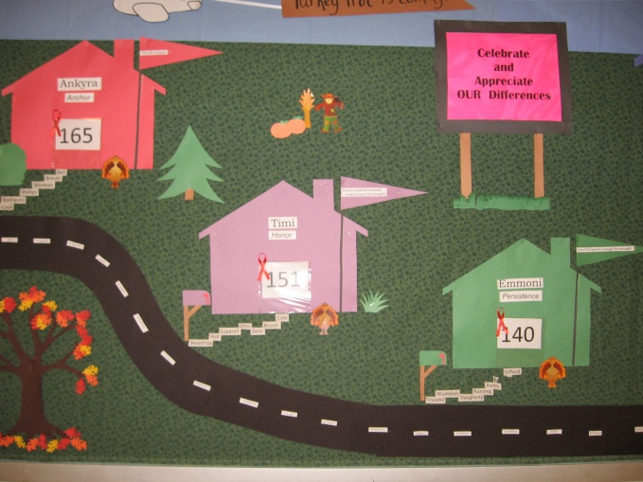
Tier 1 Competitions
We target problem behaviors by making them competitions between our 6 houses.
  Tardy Challenges No Late Homework Attendance
  Grades Office Referrals Service Learning Projects
Our houses compete for the coveted title of “Best House”.

Slide 10
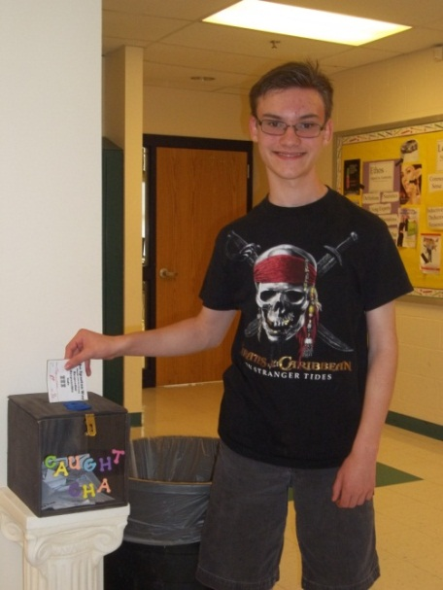
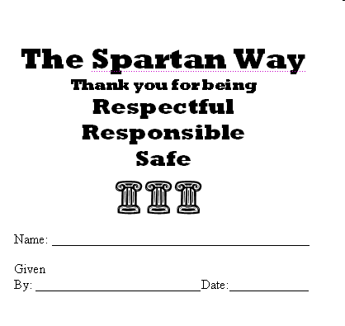
Tier 1 Reinforcement
Tear off caught-cha’s
  Students drawn weekly for prizes
  In the first year, caught-cha’s were up 1,385%!
  Over 3,758 caught-cha’s were written.
Caught Chas
need to be
simple!

Slide 11
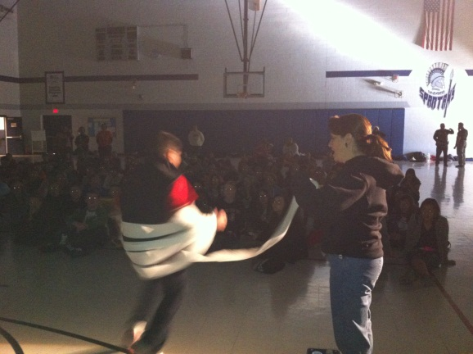
Tier 1 Reinforcement
Privilege cards
  Assemblies
  Outside Lunches
  Give-Aways
        Thanks for being on a roll! (Tootsie Rolls)
        You make smartie choices! (Smarties)
        How about s’more good behavior!
        (graham crackers & hot chocolate)
        You’ve had a super sweet year! (snow cones)

Slide 12
Spartan Way Tier 2
Students with five or more office referrals are considered for Tier 2 interventions
    PBS 101 begins at 3 referrals
Team of teachers, counselors, and administrators meet every other week to determine initial intervention and then review effectiveness of interventions.

Slide 13
Tier 2 Interventions
Check-in/Check-out
Goal is to increase positive interactions between student and teachers
Student carries sheet to each class
Teacher provides a rating on the student’s goal at the end of class along with a positive comment
Goals | 1 | 2 | 3 | 4 | 5 | 6 | 7
Respond to Teacher Appropriately | 3 2 1 | 3 2 1 | 3 2 1 | 3 2 1 | 3 2 1 | 3 2 1 | 3 2 1
Being respectful during class by not side talking | 3 2 1 | 3 2 1 | 3 2 1 | 3 2 1 | 3 2 1 | 3 2 1 | 3 2 1
Total Pts.
Teacher Initials

Slide 14
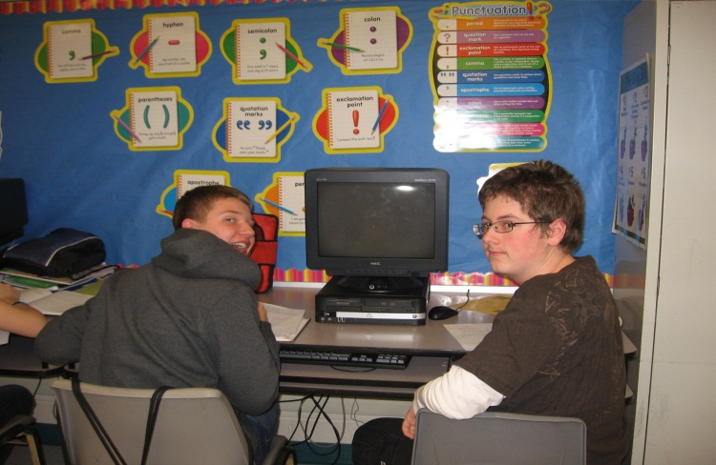
Tier 2 Interventions
Mentoring
Goal established between an adult in the school and the student
Weekly emails to teachers to evaluate how student performed on goals
Weekly touching base between the mentor and student to discuss how things are going and review ratings

Slide 15
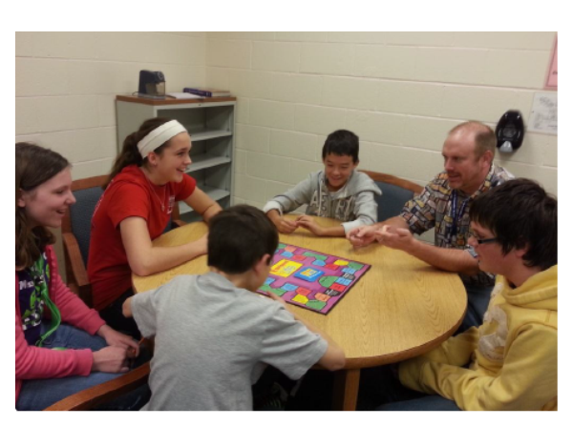
Tier 2 Interventions
Social Skills
Small group instruction
Designed to work on specific deficit skills
Goal established between instructor and student
Weekly emails to teachers to evaluate how student is performing on goals

Slide 16
Spartan Way Tier 3
Students who receive ten or more referrals are considered to be Tier 3
Functional behavior assessment completed on the student in order to develop an individual behavior plan
Conversations with parent to make them aware of efforts
Meet with team of teachers to present behavior plan
Weekly goal monitoring with teachers
Weekly meetings with student to evaluate progress

Slide 17
Home Visits
Identification of Students
Looked at three areas:
Attendance-more than 15 absences
Grades-GPA lower than 1.5 for the year
Behavior-3 or more office referrals
If student flagged in two or more of these areas, we targeted that student for a home visit.

Slide 18
Home Visits
Day of Visit
Brought individual student data to meeting
Teacher welcomed student to 8th grade and stated her desire to see the student have a successful year
We set goals and work out strategies for success before the school year began.

Slide 19
Home Visits Results
One student has left our district
Student A 9 absences (22); 3 ODR (8)
Student B 3 ODR (8); 1.58 GPA (0.54)
Student C 11 absences (15); 2 ODR (14); 2.99 GPA (1.57)
Student D 17.5 absences (22); 2.44 GPA (1.54)
Student E 6.5 absences (12.5); 1.92 GPA (1.04)
Student F 1.48 GPA (1.07)
Student G 1.50 GPA (0.92)

Slide 20
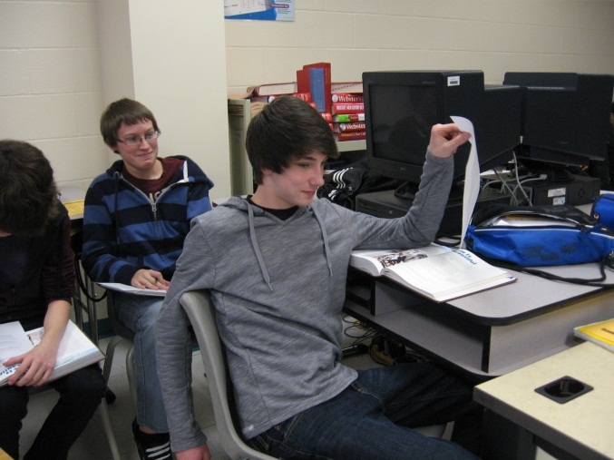
Home Visits Results
“At first, it was kind weird to have my Principal and my teacher come to my house. And then, once they were there, it was surprising. It actually wasn’t that weird. It was a good idea, because it helped me to set goals. I didn’t even realize what I needed to do. I would recommend this to other students like me who have trouble with talking out and not thinking before they do. I’ve had a much better year because of their visit.” - G.H. 8th Grade Student

Slide 21

Thwarting Tier 2!

Slide 22
PBS 101
When a student reaches 3 office referrals, they enter our PBS 101 program within 2-3 days.
During Home Base, the student is pulled for one-on-one mentoring (20-25 minutes).
We begin by asking, “Where do YOU think you’re getting in trouble? Where are you having problems?
Then, we review the 3 office referrals with the student.
Next, we ask the student if there’s a pattern.
  Same class? Same behavior?
Finally, the student writes his or her own goal.

Slide 23
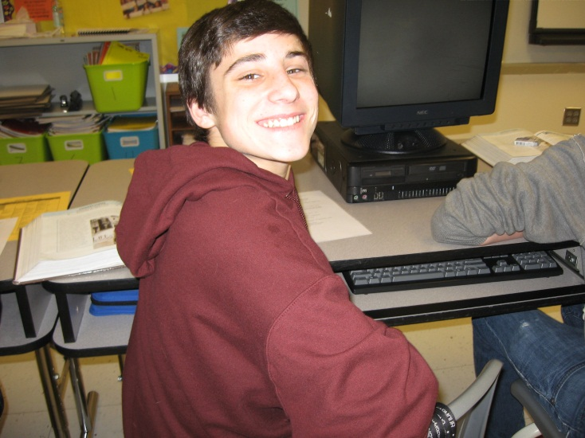
PBS 101 Student Goals
Student goals include:
  What behavior will change
  By what date (usually a month)
  Name 3 specific strategies to meet the goal

Slide 24
PBS 101

Slide 25
PBS 101
As our data is reviewed weekly, we will pull in PBS 101 students who are struggling.
Otherwise, we meet-up again at their one month review date (10-15 minute meeting).
If they’ve met their goal, we celebrate with a congratulations note, and we let them know they’re on our “watch list.”
To teach self-control, students are told to seek out their PBS 101 teacher if they are struggling.
This alone keeps nearly half from escalating to Tier 2.

Slide 26
PBS 101

Slide 27
PBS 101
During 2011 - 2012
  Tier 1 = 101 students (1-2 office referrals)
  PBS 101 = 21 students (3-4 office referrals)
  Tier 2 = 16 students
  Tier 3 = 10 students
45% of our PBS 101 students did not escalate.
During 2012 – 2013
  Tier 1 = 81 students (1-2 office referrals)
  PBS 101 = 11 students
  Tier 2 = 12 students
  Tier 3 = 1 student
46% of our PBS 101 students did not escalate.

Slide 28
PBS 101 Lessons Learned
Pulling multiple kids at one time does not work.
Having too many mentors does not work.
  We have only one PBS 101 coach – Ms. Jorel.
Students need to be pulled within days of their 3rd referral.
Informal check-ins are beneficial before the 30 day revisit.
Student ownership of the goal is essential.
Student ownership of the strategies is also essential.
Discreetly informing the teacher of any goals & strategies, that may be appropriate to their classroom, is helpful.

Slide 29
Questions?
Our contact information:
            Jennifer Jorel
            Jennifer.jorel@fhsdschools.org
            Suzan Wilson
            Suzan.wilson@fhsdschools.org
            Saeger Middle School Website
            http://fhsdsm.sharpschool.net/

